Slide 1
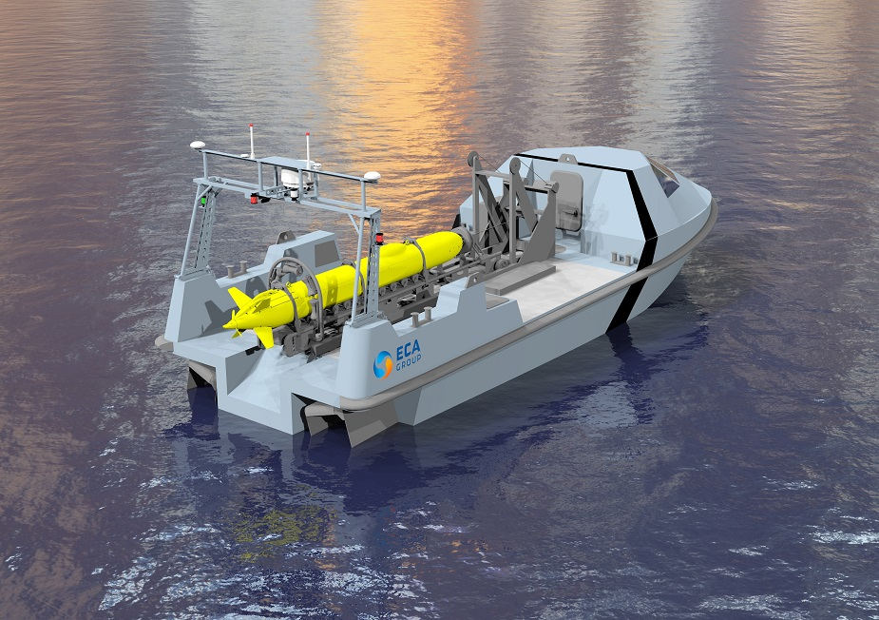
Progress Report USV Control System
Image from Naval Recognition
Notes:
Morning and welcome to my progress presentation, There are three sections to my presentation. I will begin with the background of the project as well as the motivation behind the project. Following on I begin by giving the general schematic and layout of the USV and then detail the progress that has so far been achieved in the project and explain the planned work that will be done to finish the project. Before I conclude I give a brief overview of the budget.

Slide 2
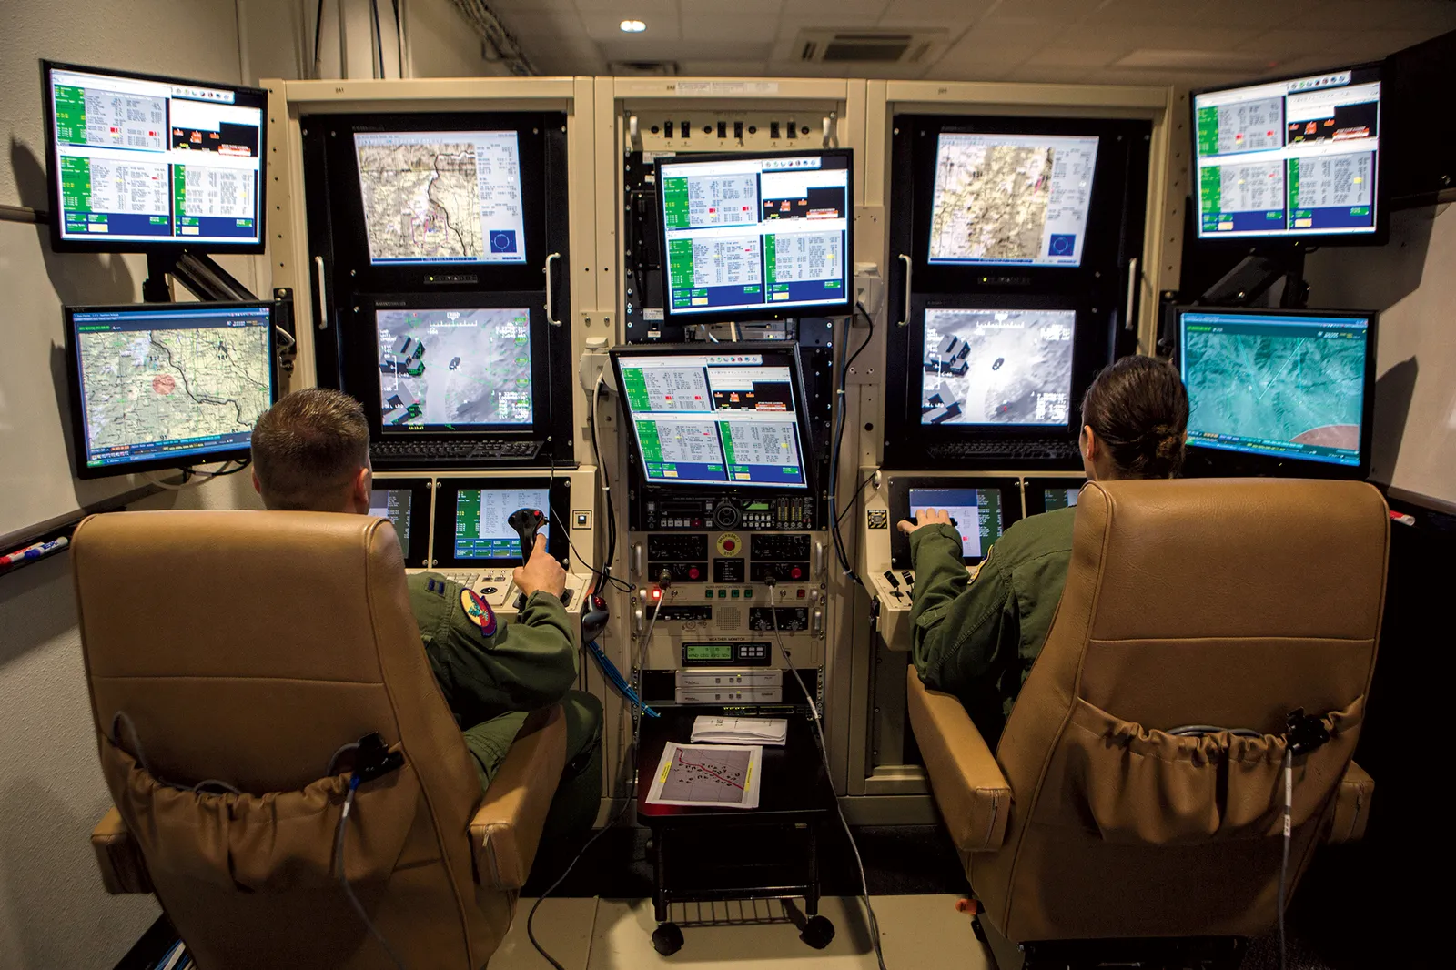
Background
USV
Unmanned Surface Vessel.
Independent Control.
Autonomous Steering.
Obstacle Avoidance.
Active Positioning Knowledge.
Off-site Control.
Open Communication Connection.
Image from GQ
Notes:
To start with, the scope of this project is to design and implement a control system for an electric USV. A USV stands for an unmanned surface vessel. A USV can either be fully independent and make use of automated steering and possibly obstacle avoidance. For independent control, the USV needs to have an active knowledge of its current position using a combination of GPS data and digital Compass. Or a USV can be controlled from an off-site location and will therefore only need to have an open communication connection between the USV and the site from where it is being controlled. In this project I will be focusing of creating an independent control USV with the focus being on the design and implementation of the control system.

Slide 3
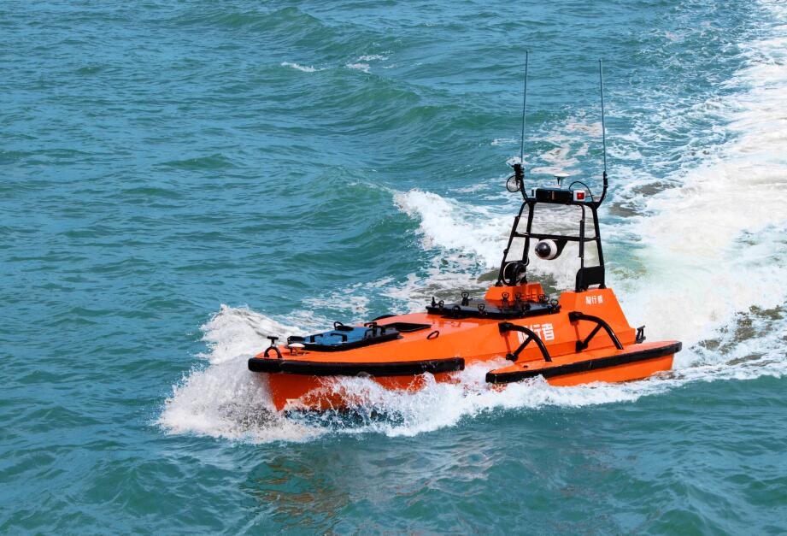
Background
Motivation
Military.
Patrolling.
Fire Support.
Research.
Marine Surveying.
Rescue.
Remote Response Time.
Image from OceanAlpha
Notes:
USVs are incredibly useful and could save a lot of money as they would be cheaper to operated than conventional manned vessels. The uses of USVs ranges from the military where they can be used similarly to UAVs for either patrolling or fire support. USVs would also have great uses in the world of marine and nature surveying. These USVs can be fitted with monitoring equipment and together with a data link and solar panels would be able to be constantly recording and transmitting data back to research facilities without having to come in for resupplies. Its only need to come in would be for scheduled or unscheduled maintenance and repairs. Finally, USVs can even be used as part of naval rescue by either having them patrolling remote areas and therefore reducing the response time to distress calls or being able to be sent into situations that might otherwise be deemed too dangerous for manned vessels.

Slide 4
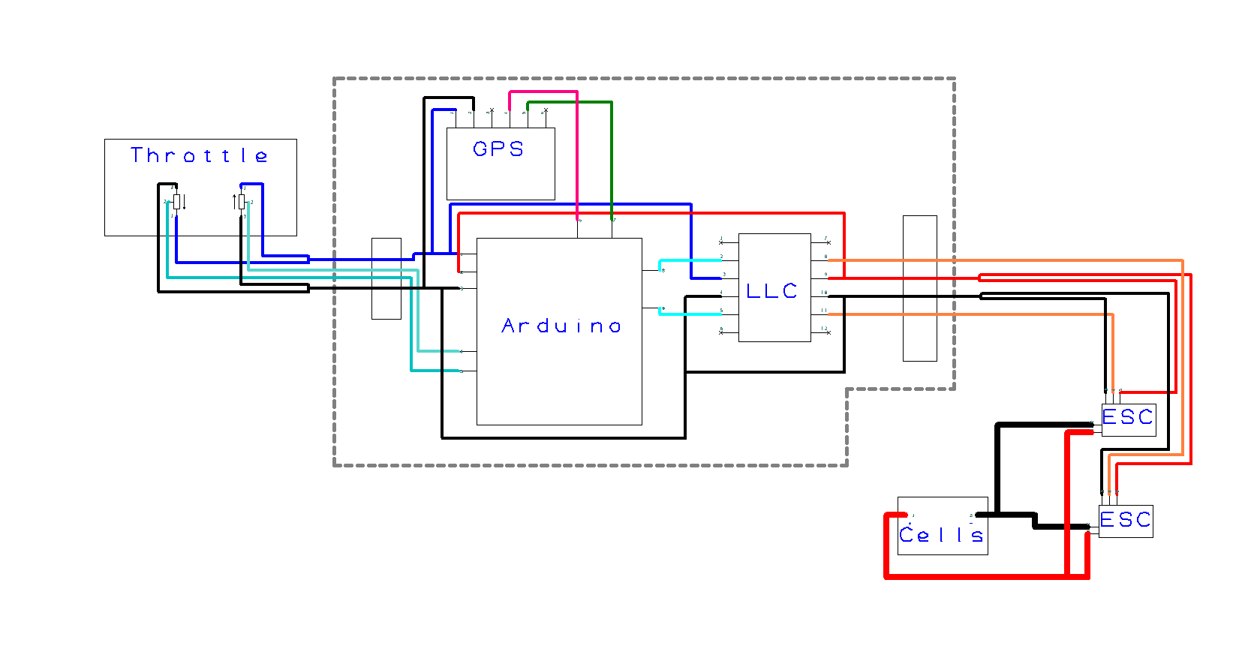
System Schematic
Image from Naval Recognition
Notes:
This is the system schematic. Inside the grey dashed area is the PCB, on which is the Arduino microcontroller, the GPS module and the Logic level converter to switch up the PWM signal from the arduinos 3V to the ESC required 5V. Outside of the grey area is the throttle system, the two thrusters which are complete units with their ESC and the Battery cells. The throttle is made up of two linear pots operating between 0 and 3V. Their signal is parsed to the Arduino ADC. The Arduino outputs two 3V PWM signals which are stepped up by the LLC and then parsed on to the thrusters. The high current draw is directly to the thrusters. The gps module operates on 3V and transmits data to the Arduino using UART.

Slide 5
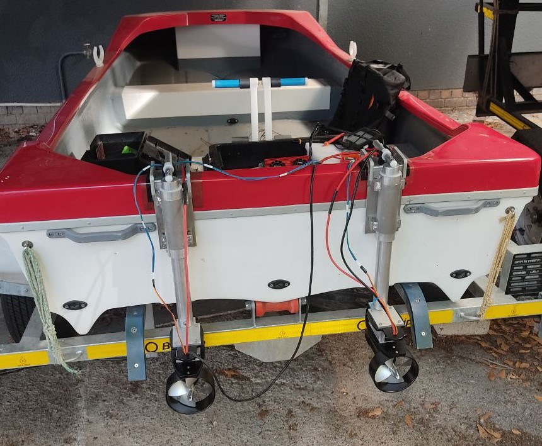
Progress
System Description
Spider 3 Boat.
TD20 Thrusters & ESC.
12V LiFePO4 Battery.
Arduino DUE Microcontroller.
PMOD GPS Module.
Photo by Luke Kingwill
Notes:
Here is the physical system. It consists of the Spider 3 boat, the two TD20 thrusters and their ESC, a 12V battery system, the Arduino microcontroller, GPS module and the throttle system. The thrusters are mounted onto the back of the boat and the battery cells are position in the well at the back so that the cables which are carrying the high current are as short as possible. The throttle will be mounted on the front bench for ease of use and the PCB will be mounted in close proximity so that the GPS module is as far from the magnetic fields of the motors and high current cables as possible.

Slide 6
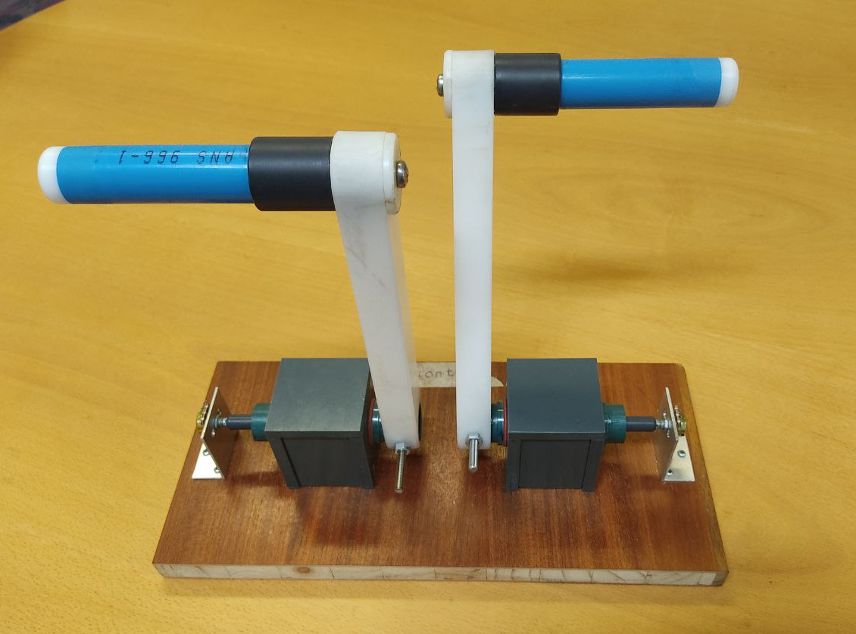
Progress
Hardware
Motor Mounts.
Throttle Assembly.
Trailer License.
PCB Board.
Soldering.
Photo by Luke Kingwill
Notes:
The thruster mounts seen in the previous slide were designed and fabricated by the E&E workshop as this is outside the scope of this project. Build throttle arms were ordered to be used in the system, however when they arrived, they were too small and had a very limited range of motion. I then designed this concept to be used with the linear pots and gave it to the E&E workshop so that they could refine it and fabricate it. Furthermore I designed the PCB I needed and had it etched out. I have now soldered all the components onto the board, and the manual control has been tested in the workshop to respond to throttle control. The trailer has also be licensed and is ready to be taken out to test.

Slide 7
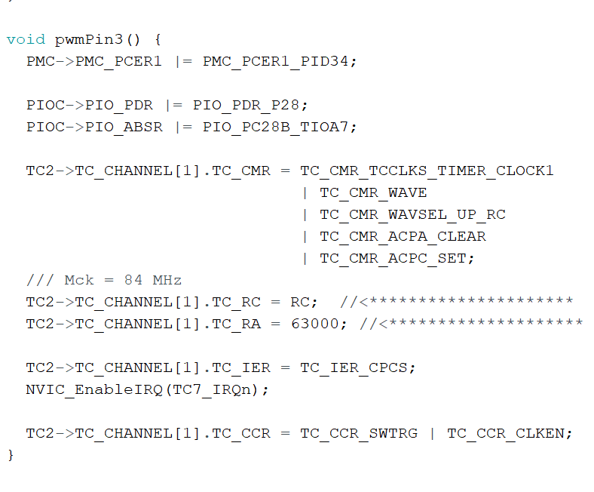
Progress
Software
Analog Read.
Adjust Timer Frequency.
Adjust Timer Duty Cycle.
Manual Control Implemented.
Receive GPS Data.
Notes:
The software is the largest part of the control system and therefore the largest part of the scope of the project. Currently the control system can operate in manual control using PWM to control the motors. The most challenging part of the PWM control was that the Arduino board has a default frequency of 1000Hz and for this project I need to output a PWM signal of 500Hz. This code segment is what sets up the timer to operate at that frequency. Basically it detaches the pin from its normal GPIO and assigns it to its peripheral B function which is the timer. The timer settings are then set, Wave form, clock 1, wave up of RC compare etc. The C & A registers are set and the itterupt is enabled. The timer will then output a 500Hz PWM signal and by adjusting the register A value, I can adjust the Duty cycle. Also complete is the software to receive the data from the GPS module.

Slide 8
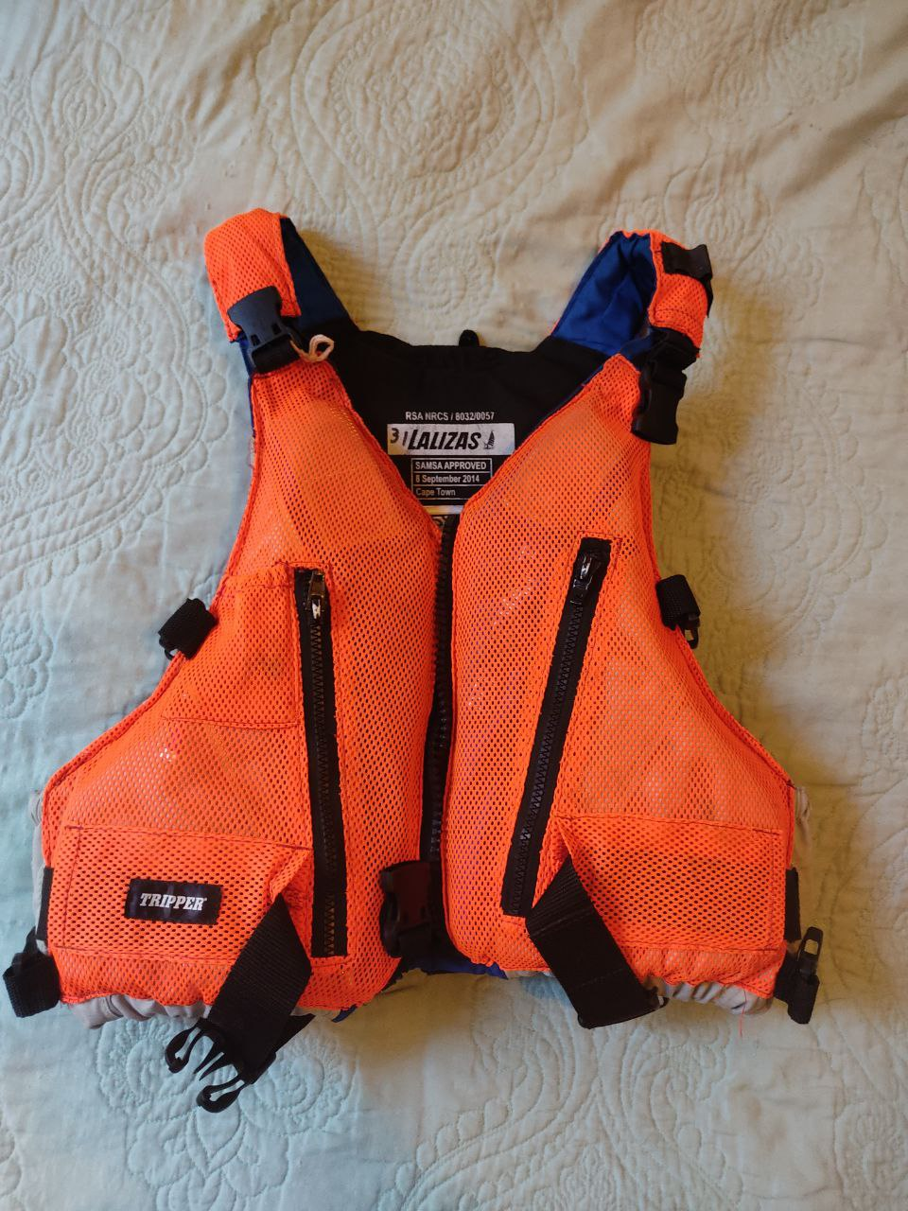
Planning
Safety
Lifejackets Worn While on the Boat.
Boat Never Unmanned.
Emergency Cut Off Switch.
Electrical Fire Extinguisher.
Water Proofing Electronics.
Photo by Luke Kingwill
Notes:
Looking forward to planning of the rest of the project. Firstly, there are several safety measures that are being implemented and will be implanted during testing. The first is that any person on the boat when it is on the water will be required to wear a life jacket. Furthermore, although it is an unmanned vessel, because it is a prototype to prove the concept, the vessel should never be unmanned in case a manual take over is required. A Emergency cutoff switch has been ordered and it will be between the batteries and the rest of the system so that if there are any issues, when that switch is switched all power will be cut off from the system. Finally an electrical fire extinguisher will be kept on board in case as well as water proofing all the electrical connections and electronics to prevent any electric shock or sparks.

Slide 9
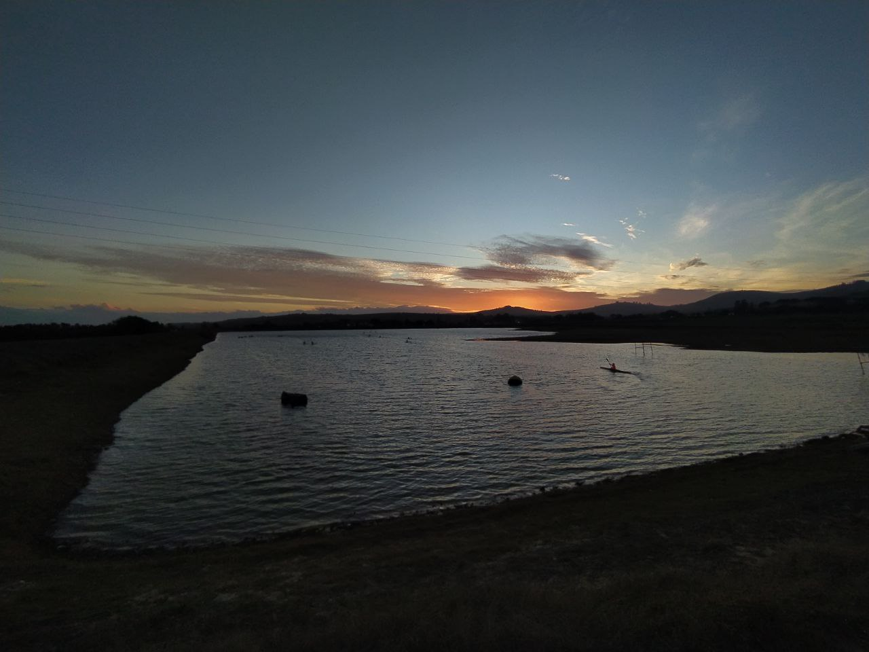
Planning
Testing
Power Test Scheduled.
Small Tests – Maties Canoe Club.
Large Tests – Theewaterskloof Dam
Photo by Rob Pike
Notes:
With regards to testing. A small power test is scheduled for this week, provided that the cut off switch is delivered in time. The power test is going to be to see how much thrust is being produced using 12 V and whether it is necessary to upgrade the battery system to 24V to prove the concept of this system. This an any other further small tests will be carried out at the Stellenbosch canoe club dam, just outside of Stellenbosch. For full large scale tests where several navigation points are going to be used, it was decided that Thewaterskloof Dam would be a good site for testing.

Slide 10
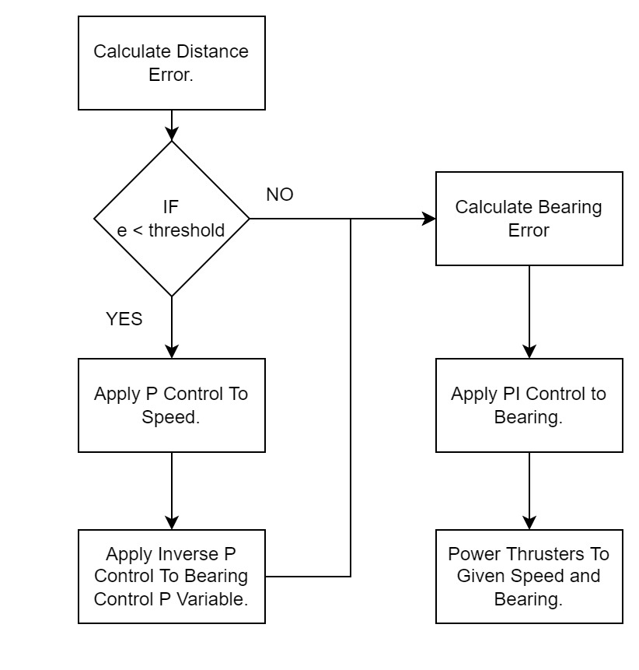
Planning
Autonomous Control
Given Set Points.
PI Control Steering.
P Control Thrust.
Notes:
Finally on the software side, the Autonmous control needs to be implemented and refined. The basic flow diagram of the autonomous control can be see here. It will use a combination of P control as well as PI control.
50% throttle, 100% right thrusters = left 50% right -50% 30% throttle, 80% right - thrusters = left 30% right -18% 80% throttle. 45% right - thrusters = left 80% right 8%

Slide 11
Planning
Budget
Description | Quantity | Item Cost | Total Cost
Spider 3 Boat & Trailer | 1 | R 16 000 | R 16 000
TD20 Thruster & ESC | 2 | R 6 500 | R 16 500*
12V Battery System | 1 | R 10 000 | R 10 000**
Arduino | 1 | R 590 | R 590
GPS Module | 1 | R 670 | R 670
Consumables & Misc | NA | R 2 000 | R 2 000
Travel | 4 | R 950 | R 3 800
 |  |  | R 49 560
*An extra ESC was ordered to replace the damaged one.
**A request for a quote has been sent to upgrade the batteries for more power.
Notes:
Driving = 150km per trip @ R3.00 per km = R450 per trip
Accom = R500 per night
Total Travel = R 950 per trip
Battery system is being quoted for to increase the power.
ESC had to be replaced.

Slide 12
Conclusion
Most of the Hardware is Complete.
The Manual Control is Operational.
Power Test Scheduled.
Autonomous Control to be Implemented.
Testing at Theewaterskloof Dam.
Notes:
In conclusion:
The PCB soldered.
Manual operation is working
Test scheduled
Autonomous control is being implemented.
Future tests at Theewaterskloof dam.

Slide 13
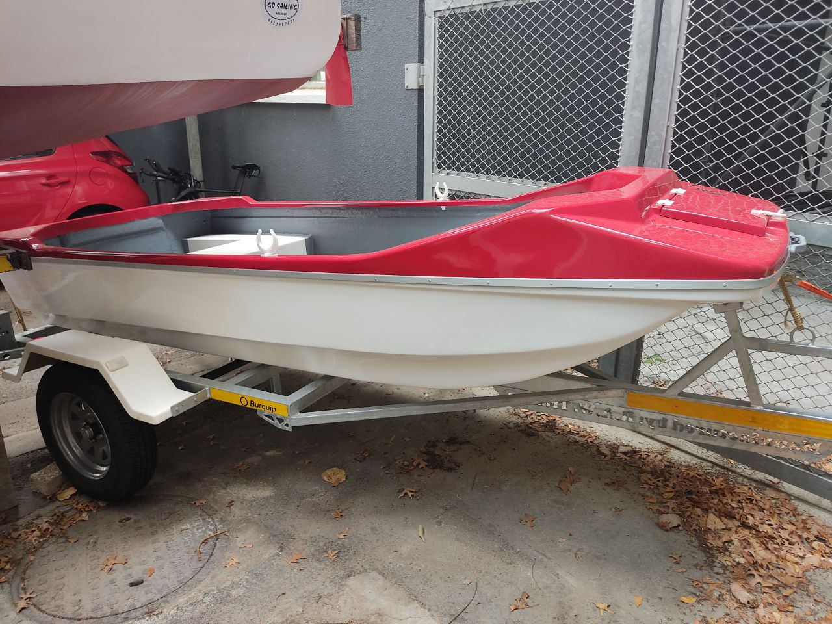
Thank you
Enkosi
Dankie
Photo by Luke Kingwill

